Slide 1
Intro to Synar
Jay Quintana
Program Coordinator

Slide 2


Slide 3
Traditional Tobacco Statement
The OSAP acknowledges the traditional and beneficial use of tobacco within many of the Native American communities in New Mexico and recognizes its place of honor and respect
within those communities. The intent of this training is to address the harmful and addictive use of tobacco, outside of its traditional, sacred, or ceremonial purposes; known as commercial tobacco use.

Slide 4
“We don’t smoke that sh*t, we just sell it. We reserve the right to smoke for the young, the black, the poor, and the stupid.”
R.J. Reynolds Tobacco Company 1992

Slide 5
Tobacco and Youth
Tobacco Use is a Pediatric Disease
88 percent of adults who have ever smoked daily report that they first smoked by the age of 18, and 99 percent report that they first smoked by the age of 26.¹
More than one-third of adults who have ever smoked report trying their first cigarette by the age of 14.¹
80 percent of adult smokers who are nicotine dependent report that they started smoking before they were 18 years old.²
USDHHS. Preventing Tobacco Use Among Youth and Young Adults: A Report of the Surgeon General,
2012.
2009 National Survey on Drug Use and Health.

Slide 6
Overview of the Problem and the Solutions
Problem
480,000 deaths annually related to smoking or exposure
88% percent of adults smoked before the age of 18
Solution
Taking steps that make it harder for youth to use tobacco
Enforce laws that prohibit the sale of tobacco
Limit tobacco marketing that is likely to be seen by youth
Educating youth and helping them make healthy choices

Slide 7
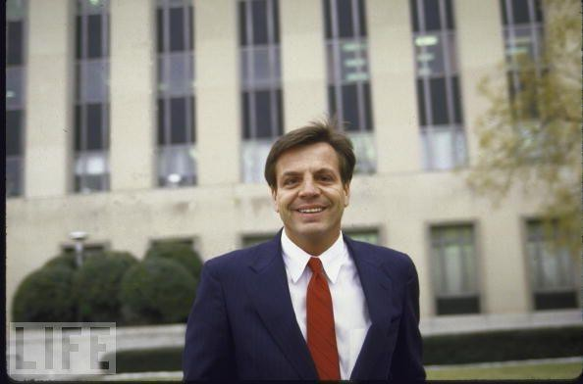
The History Behind the Synar Legislation

Slide 8
Congress calls for change to protect youth against tobacco products
In July 1992, Congress enacted the Alcohol, Drug Abuse and Mental Health Administration Reorganization Act (P.L. 102-321), which included the Synar Amendment.
The amendment requires that States enact and enforce laws prohibiting the sale and distribution of tobacco products to individuals under the age of 18.
The goal of the amendment is to reduce the number of successful illegal purchases by minors to no more than 20 percent of attempted buys by minors in each State.

Slide 9
Implementing the Synar Amendment
To implement the Synar Amendment, SAMHSA issued the Synar Regulation in
January 1996 requiring states to:
Have in effect laws prohibiting any manufacturer, retailer, or distributor of tobacco products from selling or distributing such products to any individual younger than age 18.
Enforce their laws.
Conduct annual random, unannounced inspections in a way that provides a valid probability sample of outlets accessible to minors.
Negotiate interim targets and a date to achieve a noncompliance rate of no more than 20 percent.
o Federal target of 20 percent established for States and U.S.
jurisdictions for the FFY 2003 Annual Synar Report.
Submit an Annual Synar Report detailing State activities to enforce their laws.

Slide 10
Penalty for Noncompliance
States that do not comply with the Synar requirements are subject to a penalty of 40 percent of their Federal Substance Abuse Prevention and Treatment Block Grant funding.

Slide 11
State Synar Program Compliance

Slide 12
State of New Mexico Tobacco Products Act
Law
“A PERSON LESS THAN 18 YEARS OF AGE WHO PURCHASES A TOBACCO PRODUCT, AN E-CIGARETTE OR A NICOTINE LIQUID CONTAINER IS SUBJECT TO A FINE OF UP TO $100.
A PERSON WHO SELLS A TOBACCO PRODUCT, AN E- CIGARETTE OR A NICOTINE LIQUID CONTAINER TO A PERSON LESS THAN 18 YEARS OF AGE IS SUBJECT TO A FINE OF UP TO
$1,000.”

Slide 13
What’s New?

Slide 14
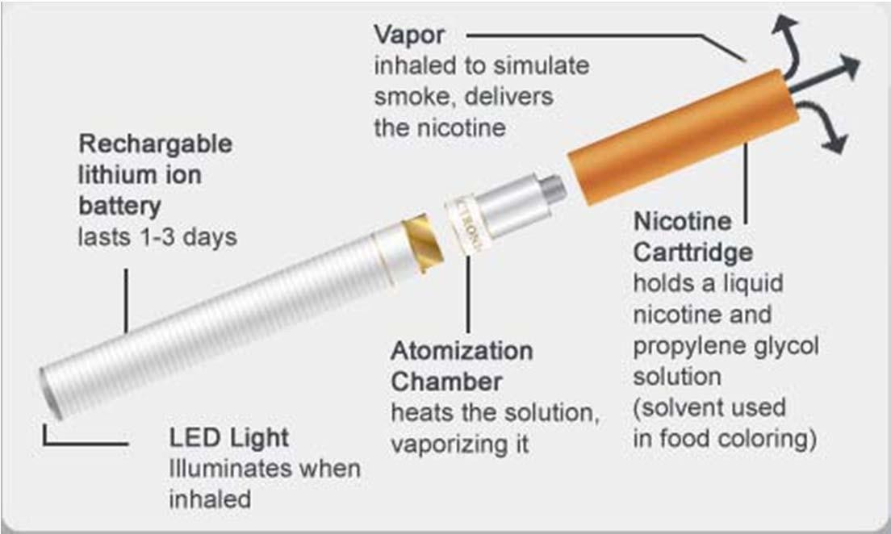
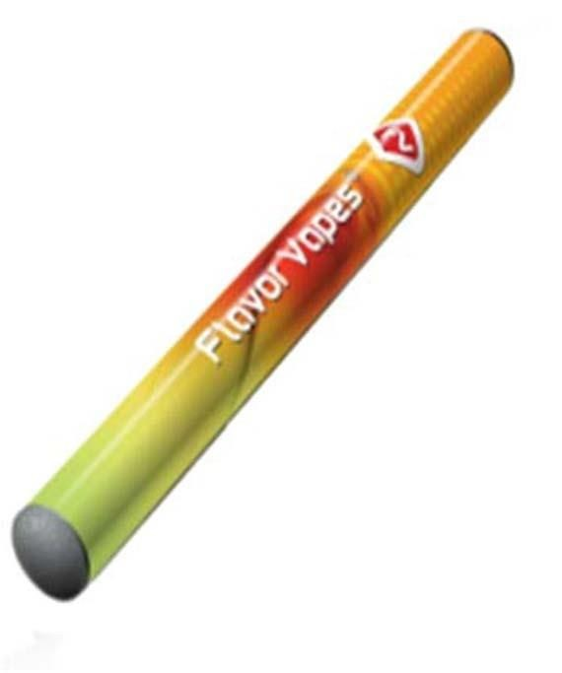
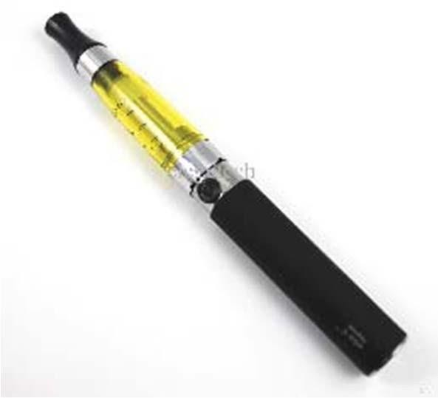
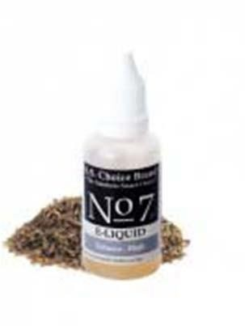
Components of E‐Cigarettes

Slide 15
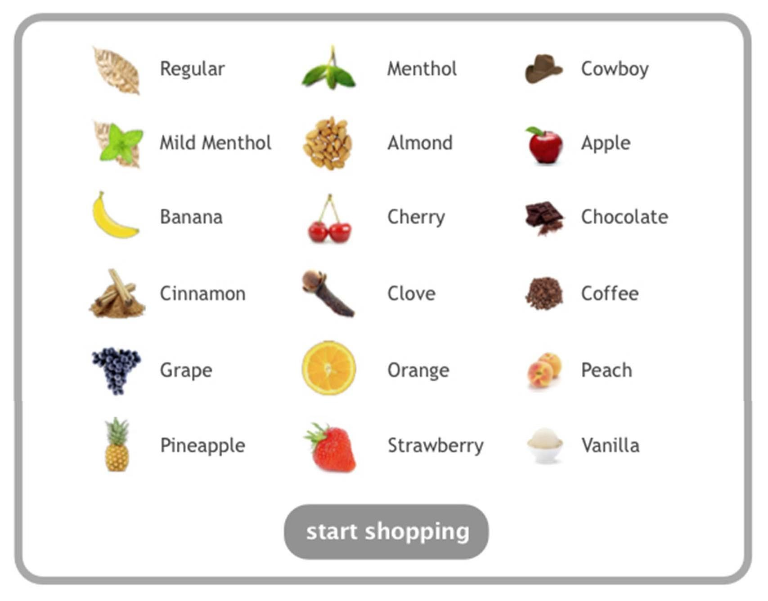
Refill Flavors

Slide 16
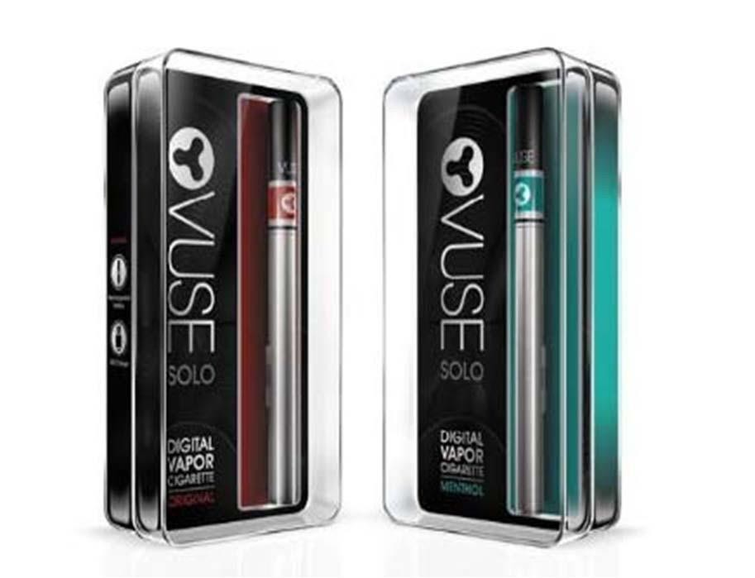
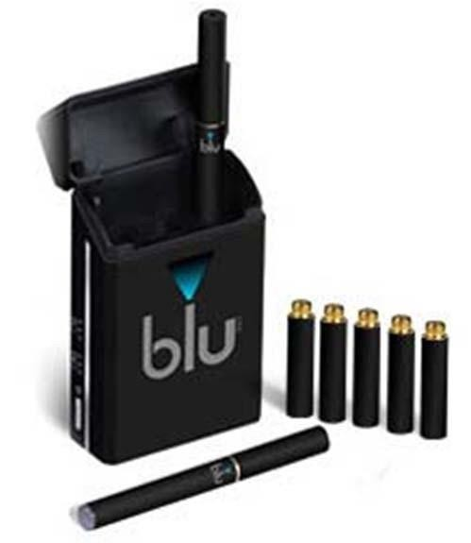

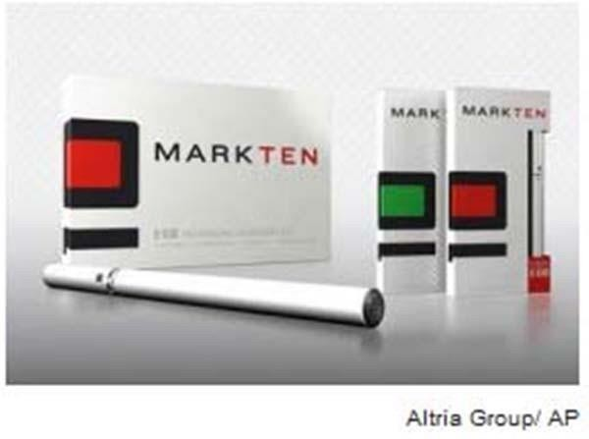


Slide 17
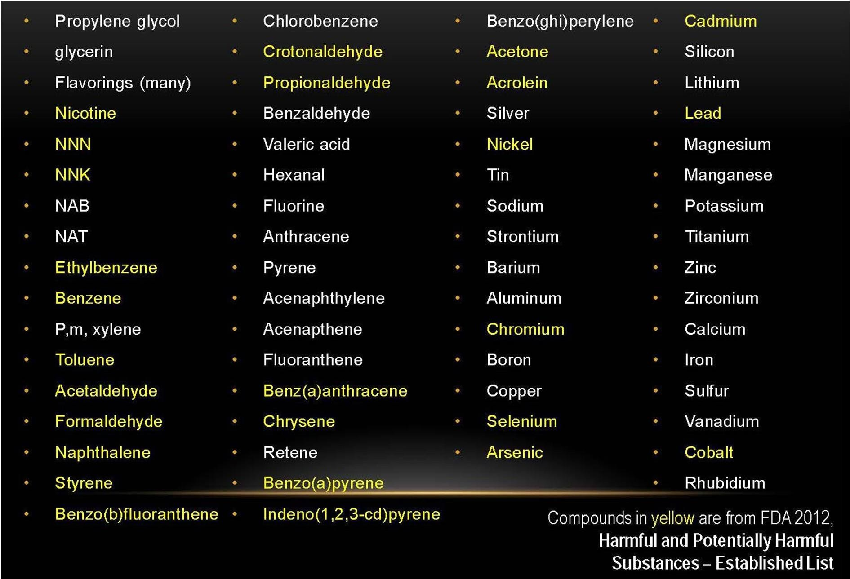
Vapor Composition

Slide 18
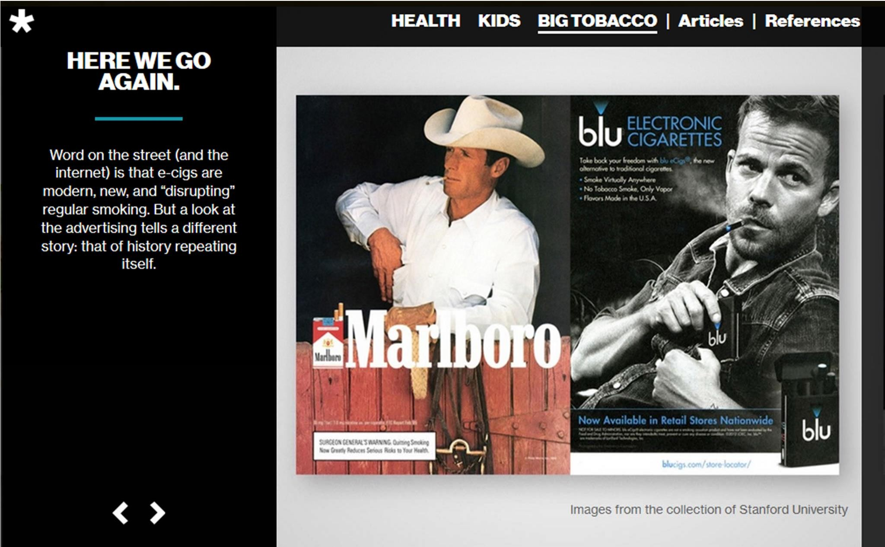
Source:
http://stillblowingsmoke.org/#bigtobacco

Slide 19
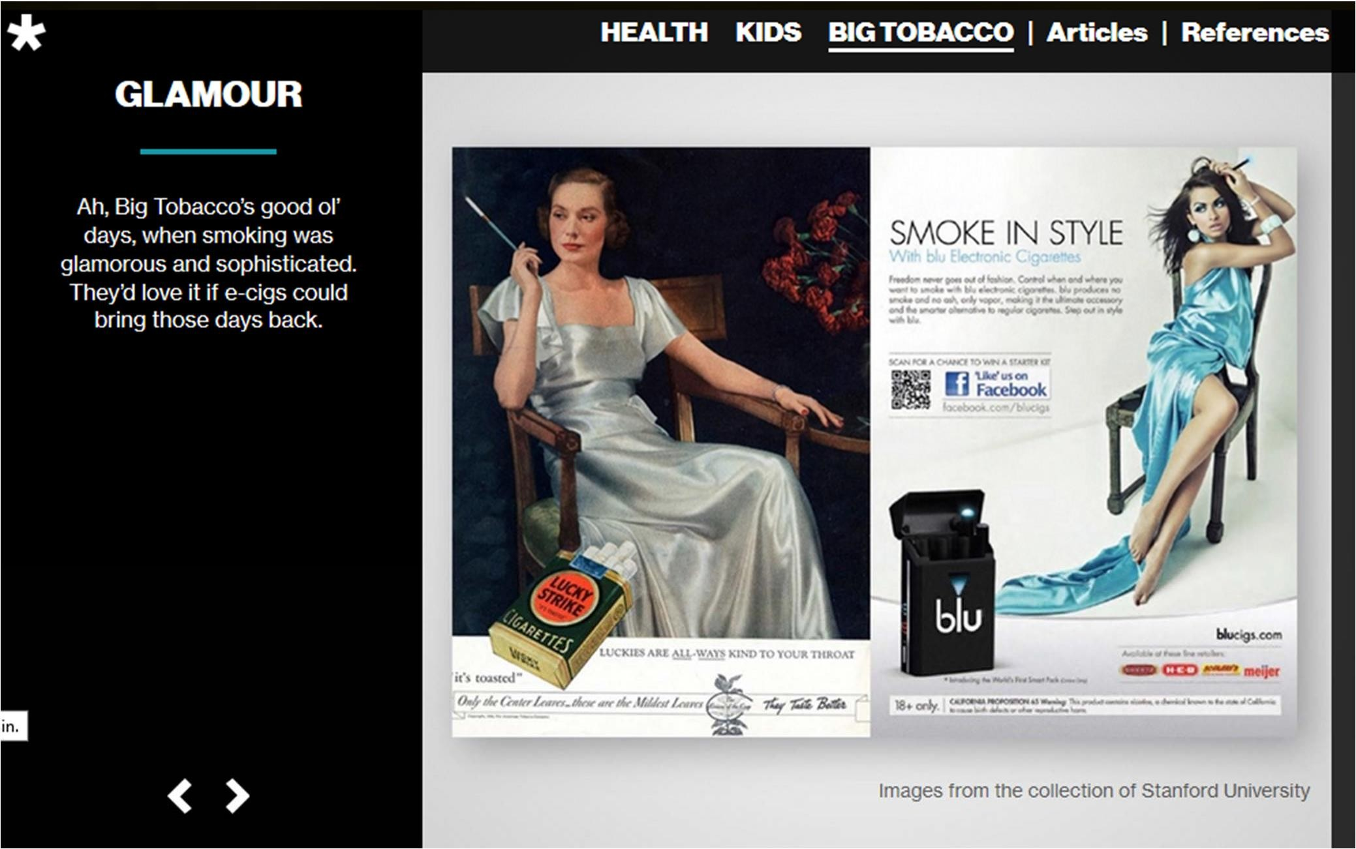
Source: http://stillblowingsmoke.org/#bigtobacco

Slide 20

Take a closer look.

Slide 21

Enforcement
New Mexico State Police (SIU)must enforce youth tobacco access laws in a manner that can reasonably be expected to reduce the extent to which tobacco products are available to individuals under the age of 18.

Slide 22

Reporting
The state must submit an annual report detailing State
activities (Annual Synar Report).
The state’s report must be made available for public comment prior to submission.

Slide 23
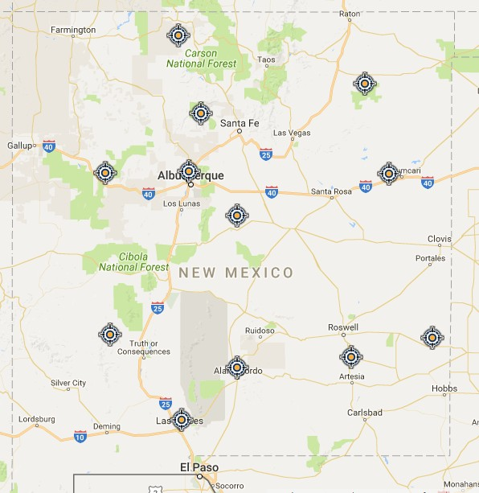
Random, Unannounced Inspections and Valid Probability Sample

Slide 24
NM Synar Components
Merchant Education
Consummated Compliance Inspections by NM SIU
Enforcement Inspections by NM SIU
Coverage Study

Slide 25
Merchant Education
Provide information summarizing laws and regulations:
– Ensure that materials are available in various languages and through various venues (i.e., print delivered via mail, print delivered in person, via Internet).
Tailor merchant education trainings to the education level of
the owner and/or employee.
Incorporate mandatory education into penalties for violators.

Slide 26
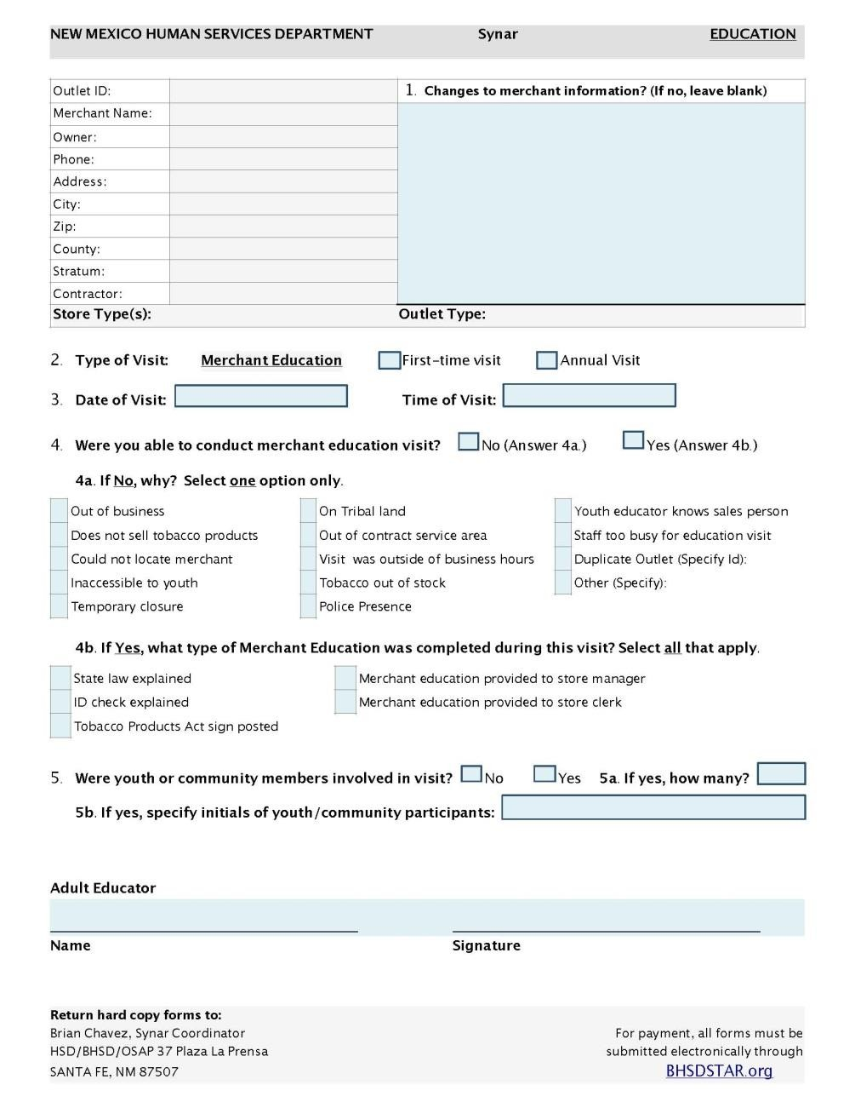
Merchant Education Form

Slide 27
Compliance Inspections
What is the objective of the Synar survey?
To determine the retailer violation rate (RVR) based on random, unannounced inspections of a sample or a census of tobacco outlets accessible to youth.
  Fact-finding mission: to obtain an accurate picture
of tobacco sales to minors statewide.
  Outlets inspected must be representative of the
tobacco outlets in the State.

Slide 29
Enforcement Inspections
By: NM State Police (SIU)
Conducted randomly and Unannounced using the
Consummated buy approach.
Enforcement to be conducted annually.

Slide 30
Coverage Study
Develop a sampling frame that includes, at a minimum, 80% of the tobacco outlets in the State (90% or better is recommended).

Slide 31
Synar Is a Success
In FFY 2018, New Mexico met the 20‐percent retailer violation target rate.
Youth tobacco use prevalence rates have dropped.
Synar is a critical component of the success of youth tobacco prevention efforts.

Slide 32
Practices for Reducing Access Reported
Statewide enforcement of merchant compliance with youth tobacco access laws
Merchant education, including non‐enforcement compliance checks conducted by community members to warn non-compliant merchants about youth access laws and provide positive reinforcement to compliant merchants

Slide 33
Practices for Reducing Access Reported
Community education and support through:
  Media‐led public education campaigns
  Support for community‐led prevention activities

Slide 34
Integration of Synar Into Overall Prevention Efforts
Require OSAP‐funded sub‐recipients (Providers) to conduct activities related to reducing youth access to tobacco products, such as:
  Visiting each tobacco retailer in their geographic area at least once a year to provide merchant education. (Providers)
  Providing trainings on request. (Providers)
  Special Investigations Unit (NM State Police) conducts SYNAR survey compliance checks and enforcement inspections in their geographic areas.

Slide 35
SYNAR ACTIVITIES
Specific to Merchant Education
Provide merchant education to assigned tobacco outlets within a 75-mile radius of the geographic area for a total of one visit per merchant. 100% of the merchant education will be conducted through in-person visits with merchants.
Provide each tobacco outlet with BHSD/Office of Substance Abuse Prevention- approved posters and signage required to be posted by New Mexico State law on the store premises, and other resource materials that explain the law to all assigned merchants selling tobacco products.

Slide 36
Objectives for Merchant Education:
After a merchant education session,
clerks/mangers should be able to:
Explain the state laws regarding selling tobacco
Explain how to properly check IDs
Tobacco signs are properly posted

Slide 37
Merchant Education
Information provided to merchants should include Human Service Department approved:
Posters and signage
Other resource materials that that explain the New Mexico Tobacco Products Act laws, penalties and fines for illegal sales
Importance of asking for identification on all tobacco sales.
Always keep a blank merchant education form on hand if you should need it for a merchant who sells tobacco in your area but was not included in your assignments.
•
The HSD approved materials are required to be
posted visibly by tobacco products
according to New Mexico State Law.

Slide 38
Merchant Tools
Information provided to merchants should include:
Information regarding the State's (and local, if applicable) youth access laws;
Product definitions;
Tips for retailers on how to ask for proof of age, how to recognize fake identification cards, how to refuse a sale; and
Details of the consequences of making an illegal sale, including who is penalized (licensee, clerk, both) and the penalty structure for violations.

Slide 39
Useful tools for Merchants
Issue a store- or company-wide directive
  Alert your managers and employees that their company will not sell tobacco products to minors
Incorporate tobacco law instruction into new employee
training
  Review law and policies with new and continuing employees
  Employees can be asked to sign agreements acknowledging understanding of policies, fines, and disciplinary actions if illegal sales are made

Slide 40
Useful for Merchants
Develop a policy regarding i.d.’s
  The policy should require all employees to request a legitimate form of picture identification from anyone who looks younger than 27.
  Make it a habit to also check the birth date. Some underage youth present ID with their correct birth date and hope the clerk won’t check.
Know the law/Post Copies of the law
  If customers complain, explain that NM State Law prohibits the sale to those under 18
  Post copies of pertinent tobacco laws in conspicuous places. Inform your employees where they are posted.

Slide 41
Useful for Merchants
Use Signs*
  Place labels and store signs on store doors, cash registers, and near tobacco displays informing customers that the retail outlet does not sell tobacco to youth.
Make tobacco products inaccessible*
  Stock should not be kept where accessible to the
public.
  By having product sales go through a clerk, the chances of theft are decreased and the chances of being asked for an ID is increased.
    * Required by NM Tobacco Products Act.

Slide 42
Useful for Merchants
Develop Policies for dealing with underage buyers who are upset
  Develop a procedure where the manager is called and the upset buyer is taken aside and told store policies.
Clerks must be informed that they should not sell to underage friends
  Employees could lose their jobs and face criminal
prosecution
  Friends who attempt to buy should be told of the law, directed to any posted signs and told of the consequences to the employee.

Slide 43
Merchant Education Forms Due
ME forms due November 26, 2019 to the Office of
Substance Abuse Prevention.
Mail to:
Human Services Department/BHSD
Office of Substance Abuse Prevention
37 Plaza La Prensa
Santa Fe, New Mexico 87504 Attn: Jay Quintana

Slide 44
Role Play

Slide 45
Questions?
Jay Quintana
Email: JayE.Quintana@state.nm.us Phone: 505-476-9285

Slide 46

References
Green D, Peñaloza L, and FitzGerald C. 2012. New Mexico Youth Risk & Resiliency Survey: High School Survey Results 2011. Epidemiology and Response Division, New Mexico
Department of Health, School and Family Support Bureau, New Mexico Public Education Department, and University of New Mexico Prevention Research
SAMHSA. (2012). FY2911 Annual Synar R=eports Tobacco Sales to Youth. Retrieved from http://www.samhsa.gov/prevention/2011-Annual-Synar-Report.pdf
United States Food and Drug Administration. (2013). Overview of the Family Smoking Prevention and Tobacco Control Act: Consumer fact Sheet. Retrieved from http://www.fda.gov/TobaccoProducts/GuidanceComplianceRegulatoryInformation/ucm246 129.htm

Slide 47
Sources
Food and Drug Administration, Flavored
Tobacco Product Fact Sheet,
http://www.fda.gov/downloads/TobaccoProducts/ProtectingKidsfromTobacco/FlavoredTobacco/UCM183214.pdf
11 Centers for Disease Control and Prevention, “Consumption of Cigarettes and Combustible Tobacco – United States, 2000 –2011.” MMWR 2012;61(30);565-569.
Justin Welby, 2018
Brian Chavez, UNM/COSAP

